Slide 1


CRYPTO PROJECT WATCH
CRYPTOCURRENCY
THE FUTURE OF MONEY

Slide 2

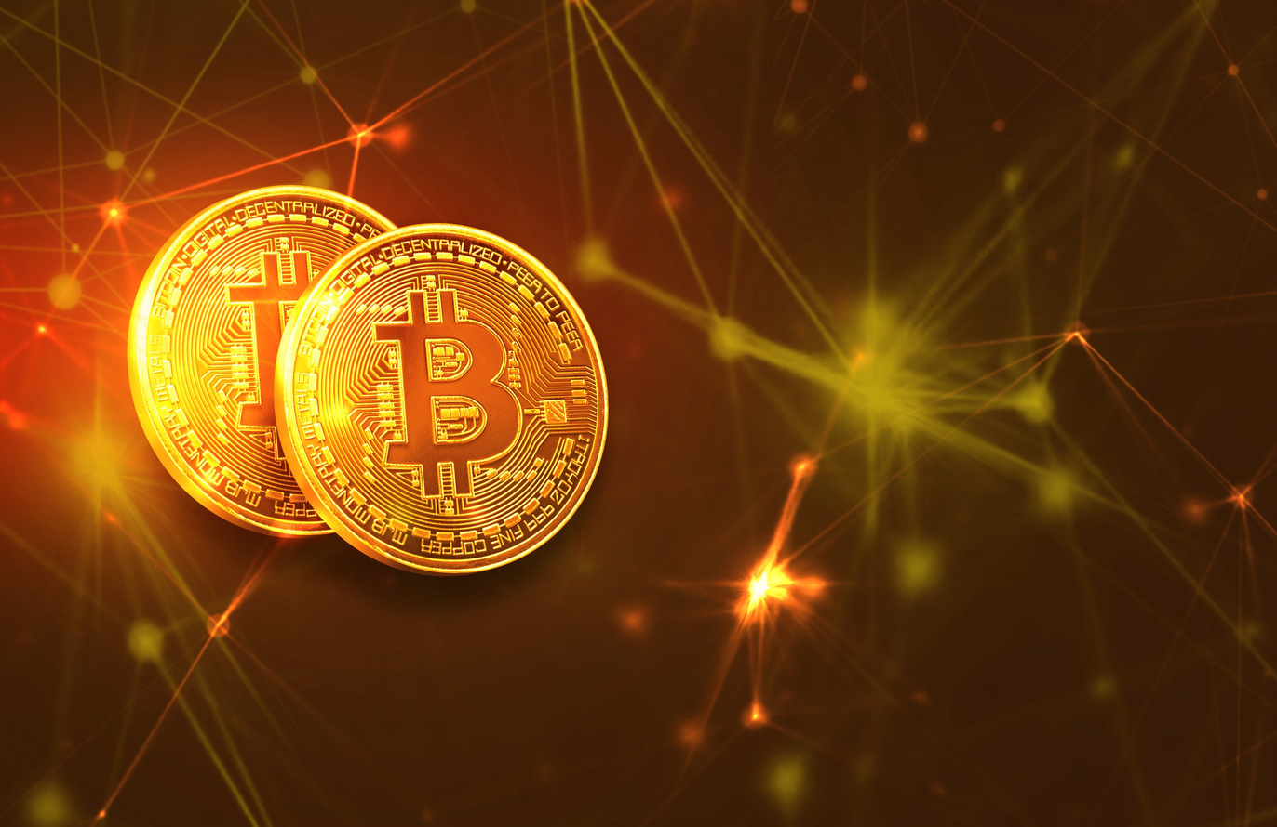
CRYPTO PROJECT WATCH
WHAT IS CRYPTOCURRENCY?
THE BASICS OF DIGITAL CURRENCY
CRYPTOCURRENCY IS A TYPE OF DIGITAL MONEY THAT EXISTS ONLINE INSTEAD OF AS CASH OR COINS YOU CAN HOLD. IT USES SPECIAL TECHNOLOGY CALLED BLOCKCHAIN TO KEEP TRACK OF TRANSACTIONS SECURELY, WITHOUT NEEDING A BANK OR GOVERNMENT TO CONTROL IT. PEOPLE CAN USE CRYPTOCURRENCY TO SEND MONEY, BUY THINGS, OR INVEST, AND TRANSACTIONS CAN HAPPEN QUICKLY BETWEEN ANYONE IN THE WORLD USING THE INTERNET.

Slide 3
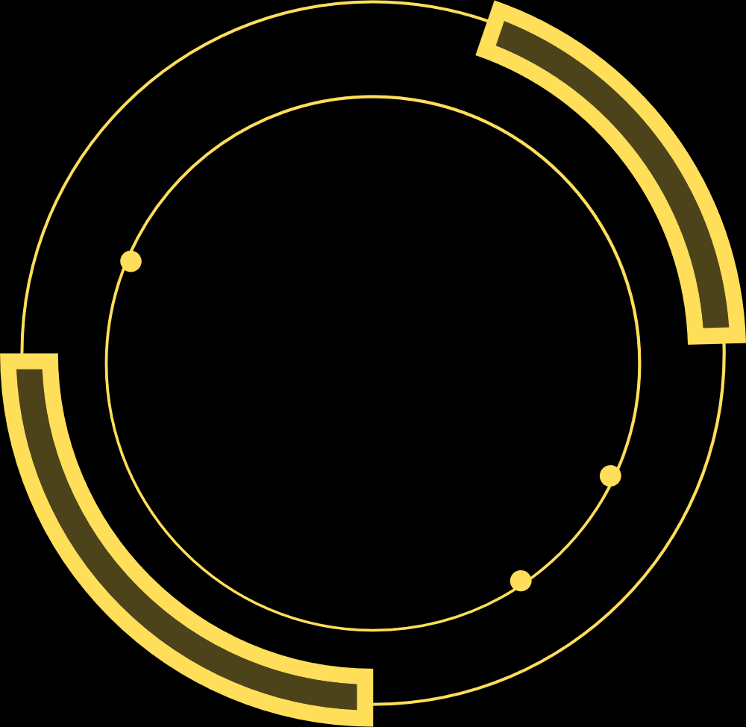
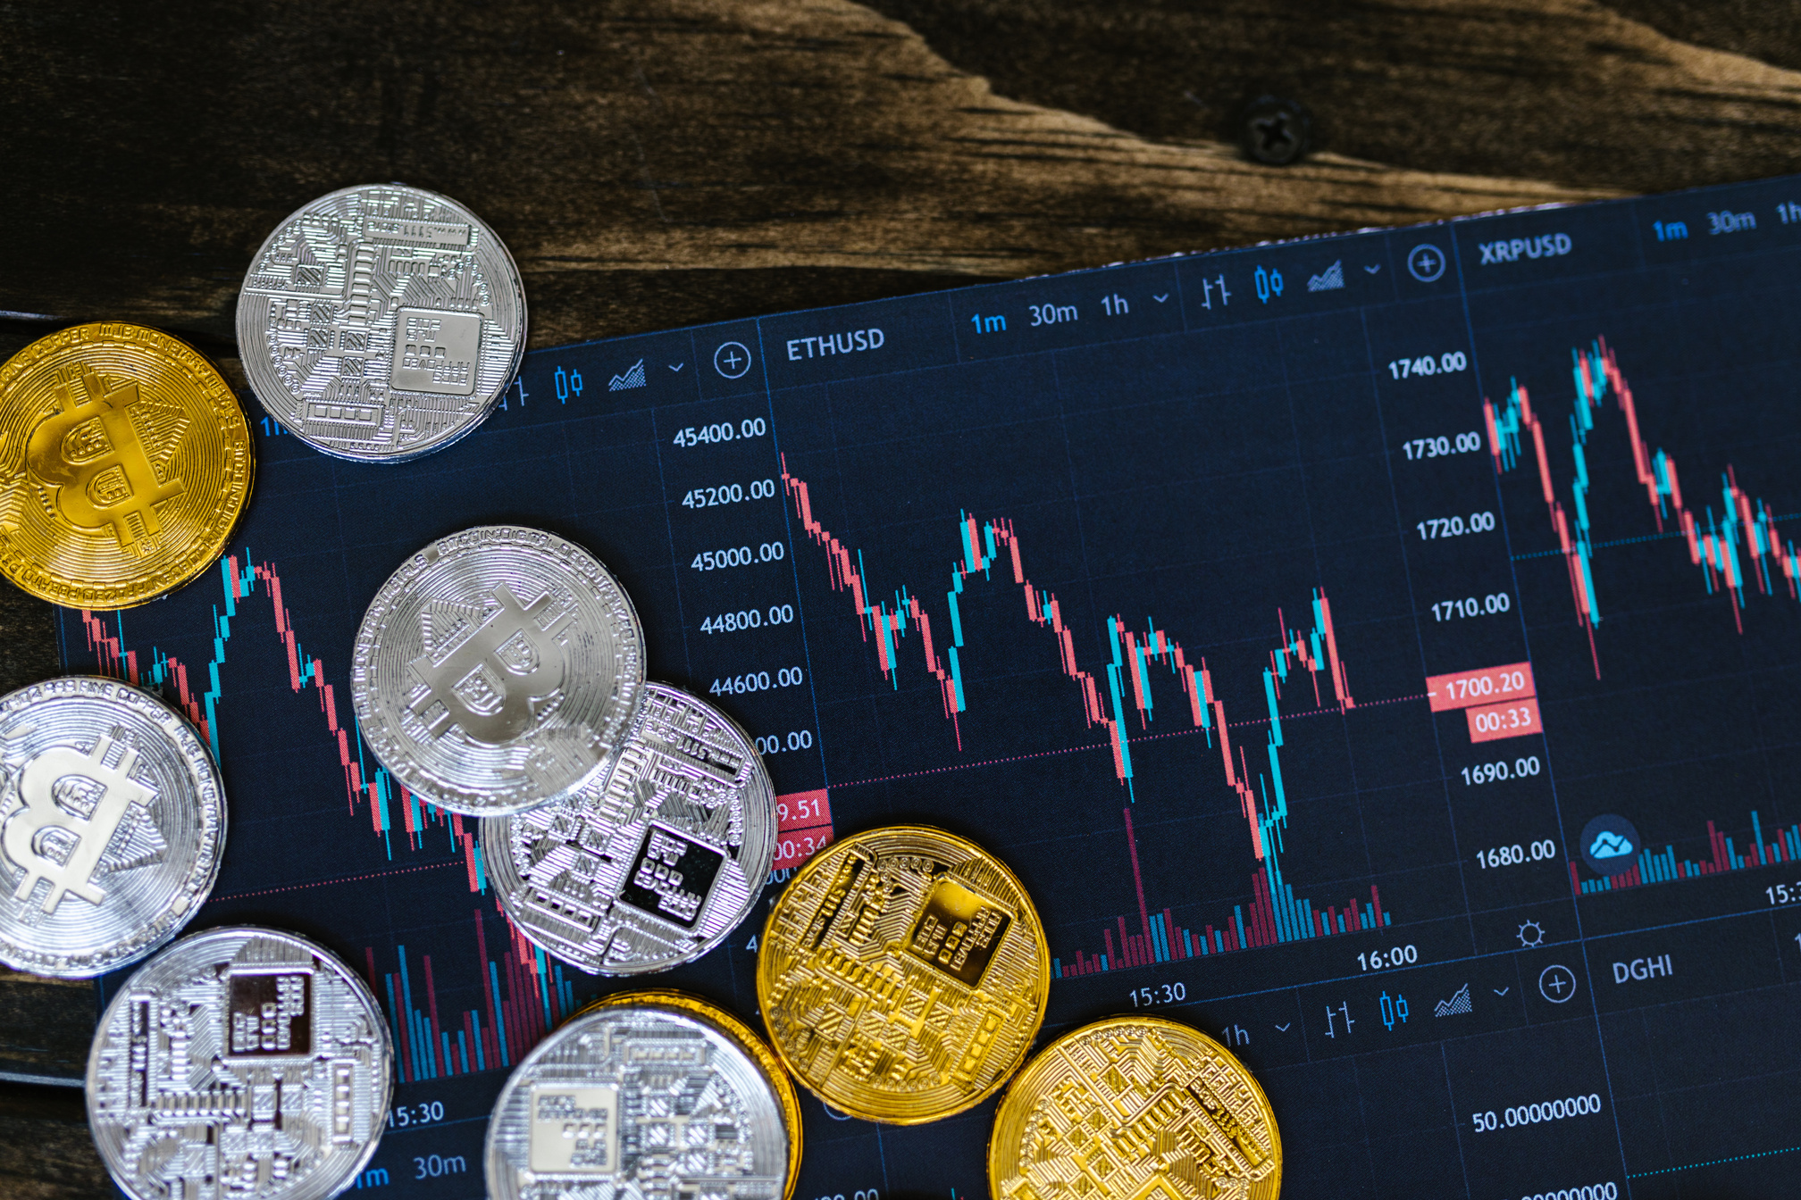

BRIEF HISTORY OF CRYPTOCURRENCY
CRYPTO PROJECT WATCH
THE EVOLUTION OF DIGITAL MONEY
CRYPTOCURRENCY BEGAN IN 2008 WHEN A PERSON (OR GROUP) USING THE NAME SATOSHI NAKAMOTO PUBLISHED A PAPER DESCRIBING BITCOIN, A NEW KIND OF DIGITAL MONEY THAT DIDN’T RELY ON BANKS. IN 2009, THE FIRST BITCOIN NETWORK WENT LIVE, ALLOWING PEOPLE TO SEND MONEY DIRECTLY TO EACH OTHER USING BLOCKCHAIN TECHNOLOGY.
FOR THE FIRST FEW YEARS, CRYPTO WAS MOSTLY USED BY TECH ENTHUSIASTS. AROUND 2013–2017, MORE CRYPTOCURRENCIES APPEARED, INCLUDING ETHEREUM, WHICH INTRODUCED SMART CONTRACTS AND EXPANDED WHAT BLOCKCHAIN COULD DO. INTEREST GREW RAPIDLY, AND BY 2020–2021 CRYPTO BECAME MAINSTREAM, WITH MAJOR COMPANIES, INVESTORS, AND INSTITUTIONS ENTERING THE SPACE. TODAY, THOUSANDS OF CRYPTOCURRENCIES EXIST, AND THE TECHNOLOGY CONTINUES TO EVOLVE INTO AREAS LIKE DECENTRALIZED FINANCE (DEFI), NFTS, AND WEB3.

Slide 4
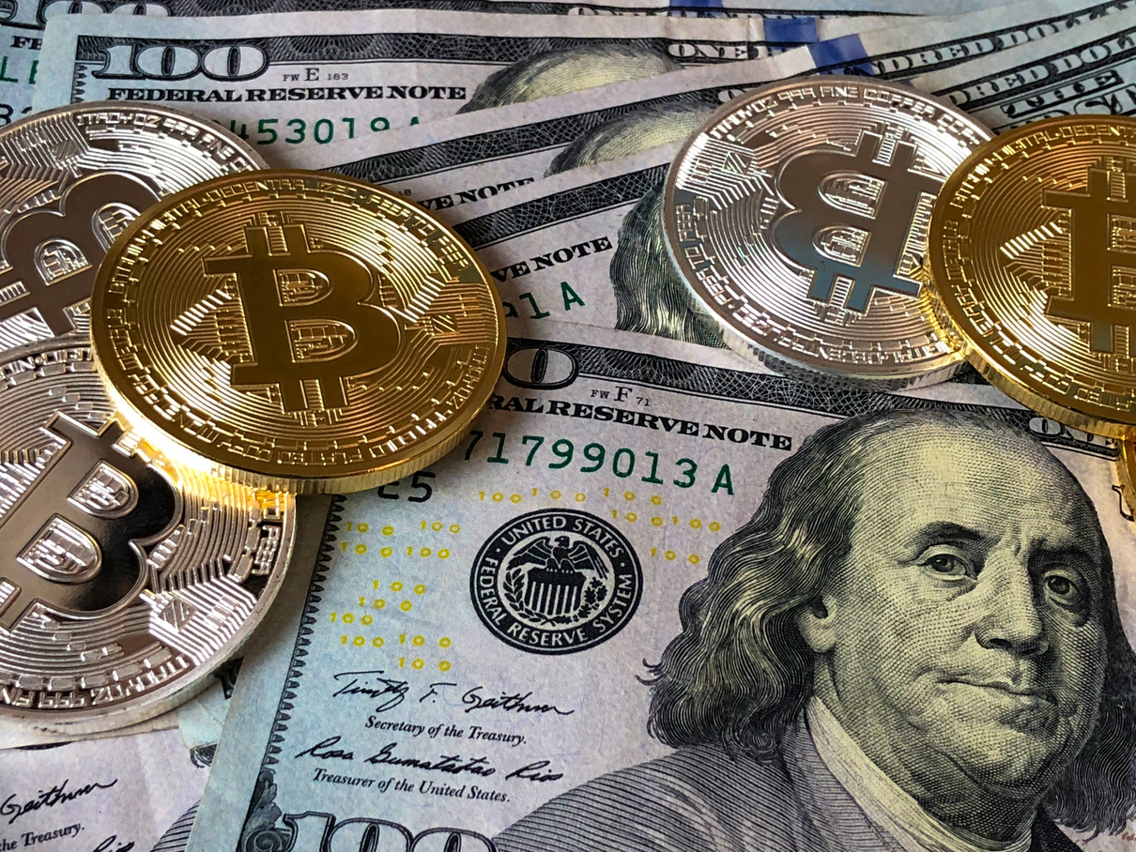
CRYPTO PROJECT WATCH
THE FUTURE OF MONEY
BLOCKCHAIN
BLOCKCHAIN IS A SECURE DIGITAL RECORD BOOK THAT STORES INFORMATION ACROSS MANY COMPUTERS INSTEAD OF IN ONE CENTRAL PLACE. EVERY TRANSACTION IS GROUPED INTO “BLOCKS” AND PERMANENTLY LINKED TOGETHER IN A CHAIN, MAKING THE DATA TRANSPARENT, TAMPER-RESISTANT, AND EASY TO VERIFY WITHOUT NEEDING A BANK OR MIDDLEMAN.
MINING
CRYPTO MINING IS THE PROCESS OF USING POWERFUL COMPUTERS TO VERIFY CRYPTOCURRENCY TRANSACTIONS AND ADD THEM TO THE BLOCKCHAIN. MINERS SOLVE COMPLEX MATHEMATICAL PROBLEMS TO KEEP THE NETWORK SECURE, AND IN RETURN THEY CAN EARN CRYPTOCURRENCY AS A REWARD FOR HELPING MAINTAIN THE SYSTEM.
HOW CRYPTOCURRENCY WORKS
WALLETS
A CRYPTO WALLET IS A TOOL THAT LETS YOU STORE, SEND, AND RECEIVE CRYPTOCURRENCY. INSTEAD OF HOLDING PHYSICAL MONEY, IT SECURELY STORES THE PRIVATE KEYS (PASSWORDS) THAT GIVE YOU ACCESS TO YOUR DIGITAL ASSETS ON THE BLOCKCHAIN, ALLOWING YOU TO MANAGE YOUR CRYPTO SAFELY FROM A COMPUTER, PHONE, OR HARDWARE DEVICE.

Slide 5

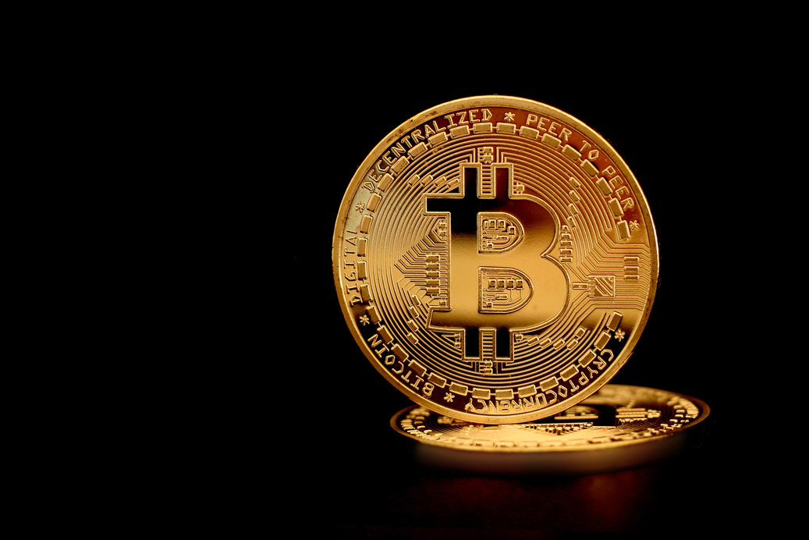
CRYPTO PROJECT WATCH
BITCOIN (BTC) – THE FIRST AND MOST WELL-KNOWN CRYPTOCURRENCY, OFTEN CALLED DIGITAL GOLD.
ETHEREUM (ETH) – A PLATFORM THAT INTRODUCED SMART CONTRACTS AND POWERS MANY CRYPTO APPS.
TETHER (USDT) – A STABLECOIN DESIGNED TO STAY CLOSE TO THE VALUE OF THE U.S. DOLLAR.
BNB (BNB) – ORIGINALLY CREATED BY THE BINANCE EXCHANGE AND USED ACROSS ITS ECOSYSTEM.
SOLANA (SOL) – KNOWN FOR FAST TRANSACTIONS AND LOW FEES.
XRP (XRP) – FOCUSED ON FAST GLOBAL PAYMENTS AND BANKING PARTNERSHIPS.
DOGECOIN (DOGE) – A POPULAR MEME COIN THAT GAINED MASSIVE COMMUNITY SUPPORT.
THESE PROJECTS REPRESENT DIFFERENT PARTS OF THE CRYPTO ECOSYSTEM—FROM PAYMENTS AND SMART CONTRACTS TO STABLECOINS AND COMMUNITY-DRIVEN TOKENS.
THE LEADING PLAYERS IN THE MARKET
BITCOIN (BTC)
ETHEREUM (ETH)
POPULAR CRYPTOCURRENCIES
BINANCE COIN (BNB)

Slide 6
CRYPTO PROJECT WATCH
BENEFITS OF CRYPTOCURRENCY
CRYPTOCURRENCY OFFERS SEVERAL BENEFITS, INCLUDING FAST GLOBAL TRANSACTIONS, LOWER FEES COMPARED TO TRADITIONAL BANKING, AND THE ABILITY TO SEND MONEY DIRECTLY TO ANYONE WITHOUT A MIDDLEMAN. IT ALSO GIVES USERS GREATER CONTROL OVER THEIR FINANCES, INCREASED TRANSPARENCY THROUGH BLOCKCHAIN TECHNOLOGY, AND ACCESS TO NEW INVESTMENT AND FINANCIAL OPPORTUNITIES IN THE GROWING DIGITAL ECONOMY.
WHY IT MATTERS
DECENTRALIZATION
SECURITY
ACCESSIBILITY
INVESTMENTS

Slide 7
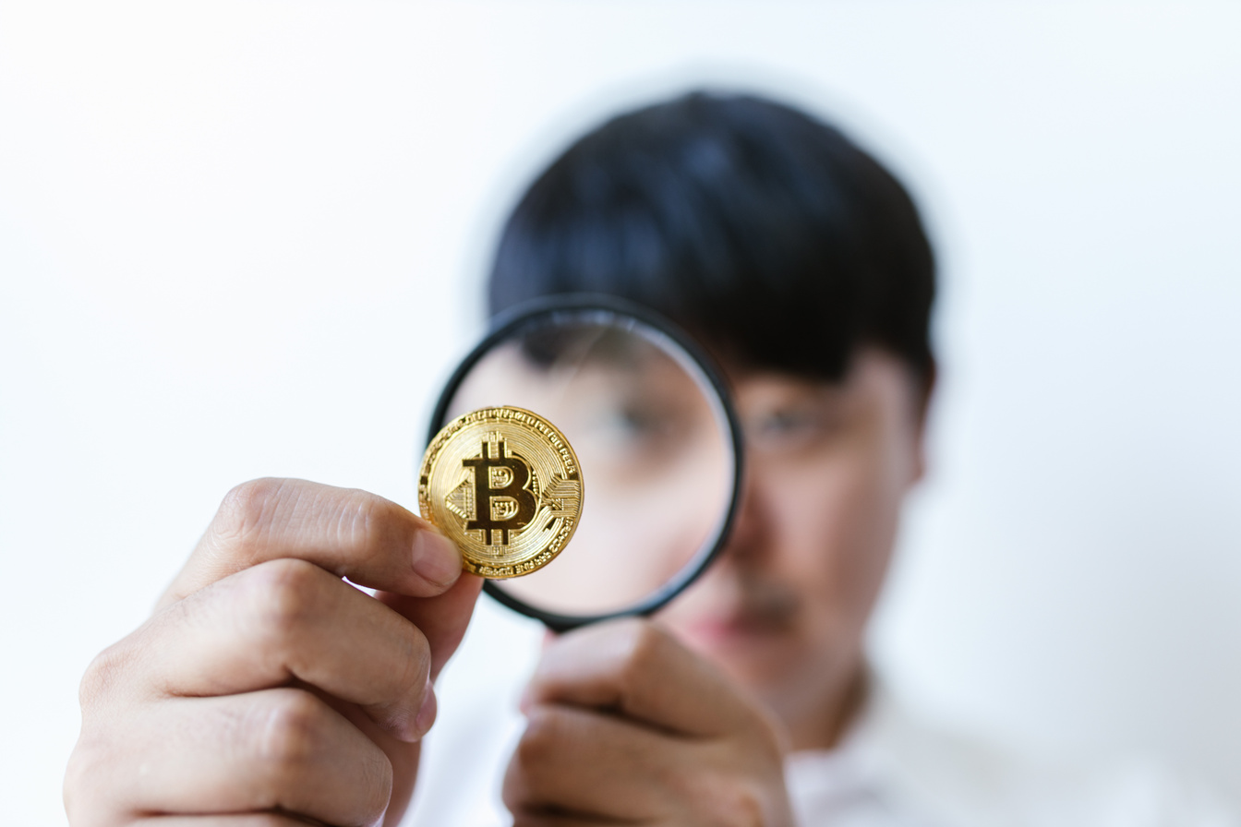

CRYPTO PROJECT WATCH
CHALLENGES
CRYPTOCURRENCY ALSO COMES WITH CHALLENGES. PRICES CAN BE VERY VOLATILE, MEANING VALUES CAN RISE OR FALL QUICKLY. SECURITY IS ANOTHER CONCERN, SINCE USERS ARE RESPONSIBLE FOR PROTECTING THEIR OWN WALLETS AND PRIVATE KEYS. REGULATIONS ARE STILL EVOLVING, WHICH CAN CREATE UNCERTAINTY, AND SCAMS OR MISINFORMATION CAN MAKE THE SPACE CONFUSING FOR BEGINNERS. ADDITIONALLY, CRYPTO CAN BE COMPLEX TO LEARN AT FIRST, REQUIRING TIME AND EDUCATION TO USE IT SAFELY AND RESPONSIBLY.
RISK
CRYPTO INVESTING CARRIES SEVERAL RISKS, INCLUDING HIGH PRICE VOLATILITY, THE POSSIBILITY OF LOSING ACCESS TO FUNDS IF PRIVATE KEYS ARE LOST, AND EXPOSURE TO SCAMS OR HACKING ATTEMPTS. BECAUSE THE INDUSTRY IS STILL DEVELOPING AND REGULATIONS ARE EVOLVING, THE VALUE AND ACCESSIBILITY OF CRYPTOCURRENCIES CAN CHANGE QUICKLY, MAKING RESEARCH, SECURITY, AND RESPONSIBLE INVESTING ESPECIALLY IMPORTANT.
CHALLENGES AND RISKS
THE FUTURE OF MONEY
THE FUTURE OF MONEY IS BECOMING MORE DIGITAL, FASTER, AND MORE GLOBAL. TECHNOLOGIES LIKE CRYPTOCURRENCY, BLOCKCHAIN, AND MOBILE PAYMENTS ARE MAKING IT EASIER TO SEND, STORE, AND MANAGE MONEY WITHOUT TRADITIONAL BANKS, WHILE CENTRAL BANK DIGITAL CURRENCIES AND FINTECH INNOVATIONS CONTINUE TO RESHAPE HOW PEOPLE INTERACT WITH FINANCE. AS THESE TECHNOLOGIES GROW, MONEY IS LIKELY TO BECOME MORE ACCESSIBLE, EFFICIENT, AND CONNECTED WORLDWIDE.

Slide 8
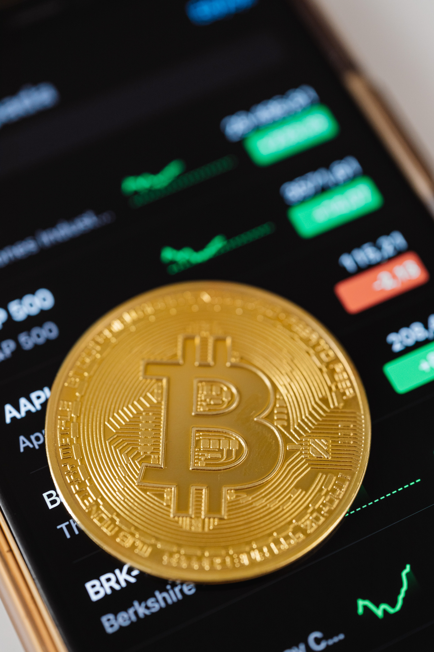
CRYPTO PROJECT WATCH
CRYPTOCURRENCY USE CASES
PAYMENTS
SMART CONTRACTS
BEYOND DIGITAL MONEY
DECENTRALIZED FINANCE (DEFI)
INVESTMENT

Slide 9
FUTURE OF CRYPTOCURRENCY
CRYPTO PROJECT WATCH
THE FUTURE OF CRYPTO IS LIKELY TO FOCUS ON WIDER ADOPTION, STRONGER REGULATION, AND DEEPER INTEGRATION WITH EVERYDAY FINANCE. WE’RE ALREADY SEEING INSTITUTIONS, BANKS, AND GOVERNMENTS EXPLORE BLOCKCHAIN, WHILE TECHNOLOGIES LIKE DECENTRALIZED FINANCE (DEFI), TOKENIZATION, AND WEB3 ARE EXPANDING HOW PEOPLE BORROW, INVEST, AND INTERACT ONLINE. AS SECURITY, USABILITY, AND REGULATION IMPROVE, CRYPTOCURRENCY AND BLOCKCHAIN ARE EXPECTED TO BECOME A MORE COMMON PART OF GLOBAL PAYMENTS, DIGITAL OWNERSHIP, AND THE OVERALL FINANCIAL SYSTEM.
WHAT LIES AHEAD
ADOPTION
INNOVATIONS
CRYPTO ADOPTION HAS GROWN RAPIDLY AS MORE PEOPLE, BUSINESSES, AND INSTITUTIONS BEGIN USING DIGITAL ASSETS FOR PAYMENTS, INVESTING, AND TECHNOLOGY DEVELOPMENT. MAJOR COMPANIES NOW ACCEPT CRYPTO, FINANCIAL PLATFORMS OFFER CRYPTO SERVICES, AND NEW BLOCKCHAIN APPLICATIONS CONTINUE TO EXPAND REAL-WORLD USE. AS EDUCATION AND INFRASTRUCTURE IMPROVE, CRYPTOCURRENCY IS BECOMING A MORE RECOGNIZED PART OF THE GLOBAL FINANCIAL SYSTEM.
CRYPTO INNOVATION CONTINUES TO EXPAND WITH NEW TECHNOLOGIES LIKE SMART CONTRACTS, DECENTRALIZED FINANCE (DEFI), NON-FUNGIBLE TOKENS (NFTS), AND FASTER, MORE SCALABLE BLOCKCHAINS. THESE ADVANCEMENTS ARE CREATING NEW WAYS TO TRADE, LEND, INVEST, AND BUILD DIGITAL APPLICATIONS WITHOUT TRADITIONAL MIDDLEMEN. AS THE TECHNOLOGY EVOLVES, INNOVATION IS HELPING MAKE CRYPTOCURRENCY MORE USEFUL, ACCESSIBLE, AND INTEGRATED INTO EVERYDAY LIFE.
CENTRAL BANK DIGITAL CURRENCIES
WALLETS
CENTRAL BANK DIGITAL CURRENCIES (CBDCS) ARE DIGITAL VERSIONS OF A COUNTRY’S OFFICIAL CURRENCY ISSUED AND BACKED BY ITS CENTRAL BANK. UNLIKE CRYPTOCURRENCIES, THEY ARE CENTRALIZED AND DESIGNED TO WORK ALONGSIDE EXISTING FINANCIAL SYSTEMS WHILE OFFERING FASTER PAYMENTS, IMPROVED EFFICIENCY, AND GREATER FINANCIAL INCLUSION. MANY COUNTRIES ARE RESEARCHING OR TESTING CBDCS AS PART OF THE FUTURE OF DIGITAL MONEY.
CRYPTO WALLET INNOVATION IS MAKING DIGITAL ASSETS EASIER AND SAFER TO USE THROUGH FEATURES LIKE BIOMETRIC SECURITY, MULTI-SIGNATURE PROTECTION, SOCIAL RECOVERY, AND SEAMLESS MOBILE APPS. MODERN WALLETS CAN CONNECT DIRECTLY TO DECENTRALIZED APPS (DAPPS), SUPPORT THOUSANDS OF TOKENS, AND EVEN INTEGRATE HARDWARE SECURITY FOR COLD STORAGE. THESE ADVANCEMENTS ARE HELPING MAKE CRYPTO MORE USER-FRIENDLY AND ACCESSIBLE TO EVERYDAY USERS.

Slide 10
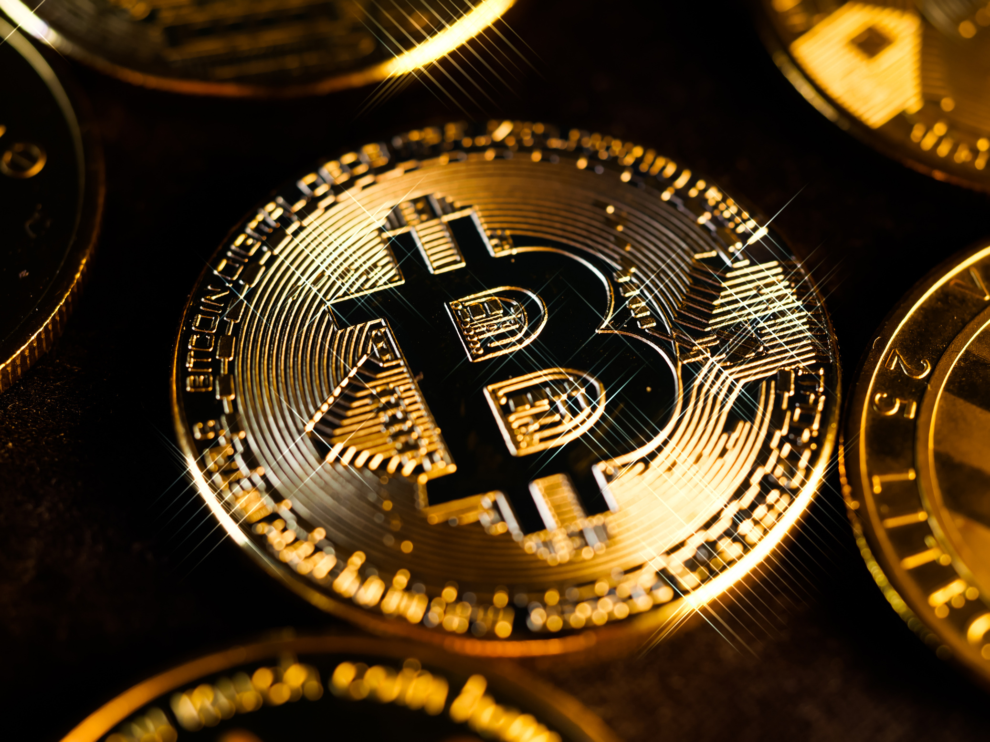
CRYPTO PROJECT WATCH
CASE STUDIES AND EXAMPLES
BITCOIN AS A "DIGITAL GOLD" USED FOR HEDGING AGAINST INFLATION
TRADING BOTS (AURUM)
ETHEREUM TRANSFORMING INDUSTRIES THROUGH SMART CONTRACTS
How have Trading BOTS changed crypto?
  Trades could be executed 24/7 without manual monitoring
  The bot reacted to market changes faster than a human could
  Emotional decisions (panic selling or FOMO buying) were reduced
  Users can reinvest gains or withdraw funds as needed
Outcome:
Over time, users gain consistent exposure to the crypto market without needing to become a full-time trader. The automation allowes users to focus on learning about crypto and growing confidence while participating in the market in a structured way.
EL SALVADOR ADOPTING BITCOIN AS LEGAL TENDER

Slide 11
CRYPTO PROJECT WATCH
CRYPTO TERMS
DEFI
SMART CONTRACTS
DEFI, SHORT FOR DECENTRALIZED FINANCE, IS A SYSTEM OF FINANCIAL SERVICES BUILT ON BLOCKCHAIN TECHNOLOGY THAT ALLOWS PEOPLE TO BORROW, LEND, TRADE, AND EARN INTEREST WITHOUT TRADITIONAL BANKS OR INTERMEDIARIES. INSTEAD, DEFI USES SMART CONTRACTS TO AUTOMATE TRANSACTIONS AND MAKE FINANCIAL TOOLS ACCESSIBLE TO ANYONE WITH AN INTERNET CONNECTION.
SMART CONTRACTS ARE SELF-EXECUTING DIGITAL AGREEMENTS STORED ON A BLOCKCHAIN THAT AUTOMATICALLY CARRY OUT ACTIONS WHEN CERTAIN CONDITIONS ARE MET. BECAUSE THEY RUN ON CODE AND DON’T RELY ON INTERMEDIARIES, THEY HELP MAKE TRANSACTIONS FASTER, MORE TRANSPARENT, AND HARDER TO TAMPER WITH.
FINTECH
WEB3
FINTECH, SHORT FOR FINANCIAL TECHNOLOGY, REFERS TO THE USE OF MODERN TECHNOLOGY TO IMPROVE AND AUTOMATE FINANCIAL SERVICES. IT INCLUDES TOOLS LIKE MOBILE BANKING APPS, DIGITAL PAYMENTS, INVESTMENT PLATFORMS, AND CRYPTOCURRENCY SERVICES THAT MAKE MANAGING MONEY FASTER, EASIER, AND MORE ACCESSIBLE.
WEB3 REFERS TO THE NEXT GENERATION OF THE INTERNET BUILT ON BLOCKCHAIN TECHNOLOGY, WHERE USERS HAVE MORE CONTROL OVER THEIR DATA, DIGITAL IDENTITY, AND ONLINE ASSETS. INSTEAD OF RELYING ON LARGE CENTRALIZED PLATFORMS, WEB3 USES DECENTRALIZED NETWORKS AND SMART CONTRACTS TO ENABLE PEER-TO-PEER INTERACTIONS, DIGITAL OWNERSHIP, AND NEW ONLINE SERVICES.

Slide 12
CRYPTO PROJECT WATCH
CRYPTO TERMS
CRYPTO EXCHANGE
NFT’S
A CRYPTO EXCHANGE IS AN ONLINE PLATFORM WHERE PEOPLE CAN BUY, SELL, AND TRADE CRYPTOCURRENCIES LIKE BITCOIN AND ETHEREUM. IT WORKS SIMILARLY TO A STOCK EXCHANGE BUT FOR DIGITAL ASSETS, ALLOWING USERS TO CONVERT MONEY INTO CRYPTO, SWAP BETWEEN DIFFERENT COINS, AND TRACK MARKET PRICES IN REAL TIME.
AN NFT, OR NON-FUNGIBLE TOKEN, IS A UNIQUE DIGITAL ASSET STORED ON A BLOCKCHAIN THAT REPRESENTS OWNERSHIP OF A SPECIFIC ITEM, SUCH AS DIGITAL ART, MUSIC, VIDEOS, OR VIRTUAL COLLECTIBLES. UNLIKE CRYPTOCURRENCIES, WHICH ARE INTERCHANGEABLE, EACH NFT IS ONE-OF-A-KIND AND CANNOT BE REPLACED WITH SOMETHING IDENTICAL.
STABLE COIN
MEME COIN
A STABLECOIN IS A TYPE OF CRYPTOCURRENCY DESIGNED TO KEEP A STEADY VALUE BY BEING TIED TO A STABLE ASSET, USUALLY A FIAT CURRENCY LIKE THE U.S. DOLLAR. THIS HELPS REDUCE THE PRICE VOLATILITY COMMON IN OTHER CRYPTOCURRENCIES, MAKING STABLECOINS USEFUL FOR TRADING, PAYMENTS, AND STORING VALUE WITHIN THE CRYPTO ECOSYSTEM. USDT, USDC
A MEME COIN IS A CRYPTOCURRENCY INSPIRED BY INTERNET JOKES, MEMES, OR POP CULTURE RATHER THAN A SPECIFIC TECHNICAL USE CASE. WHILE MANY START AS FUN OR COMMUNITY-DRIVEN PROJECTS, SOME GAIN LARGE FOLLOWINGS AND REAL MARKET VALUE THROUGH STRONG ONLINE COMMUNITIES AND SOCIAL MEDIA ATTENTION.

Slide 13
LETS TALK AURUM
CRYPTO PROJECT WATCH
AURUM TRADING BOTS
ESTABLISHED COMPANY
LED BY BRYAN BENSON OF BINANCE, BOTS RUNNING SINCE FEB 2023
HEADQUATERS IN DUBAI, LICENSED FINANCIAL AND TRADING COMPANY
NEO BANKING
NEO BANKING WITH AURUM AVAILABLE TODAY. DEBIT CARDS, STAKING, TRADING, LOANS
DAILY PAYOUTS
GET PAID DAILY, YOU DECIDE TO KEEP THE PROFIT OR ROLL IT BACK IN. BOTS DO ALL THE WORK YOU KEEP THE REWARDS
ADDITIONAL BOTS AVAILABLE
ONCE YOU ARE PART OF AURUM ADDITIONAL BOTS AND FEATURES ARE OPENED TO YOU
LOW ENTRY POINT
FOR $19.99 A YEAR AND A MINIMUM DEPOSIT OF $100 YOU CAN START YOUR AURUM JOURNEY

Slide 14
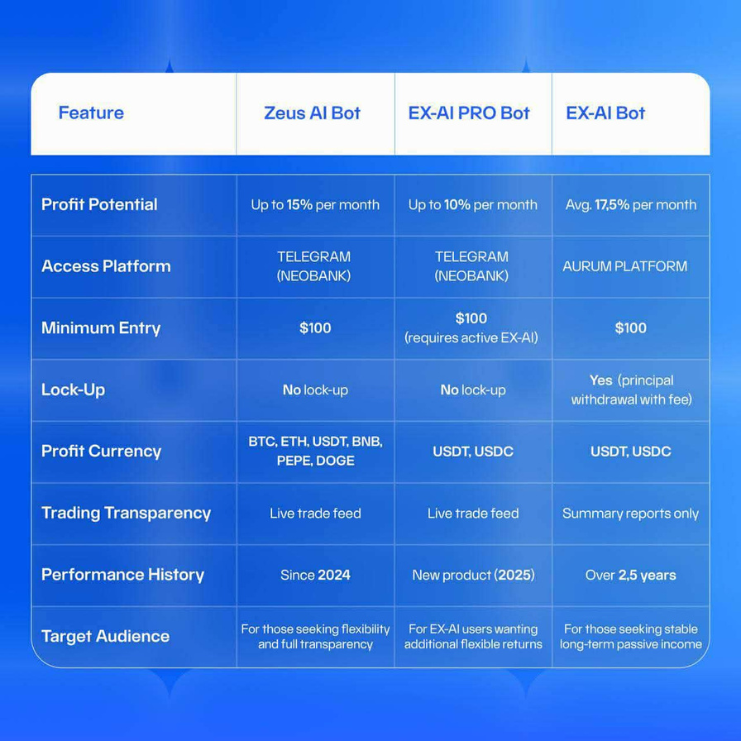
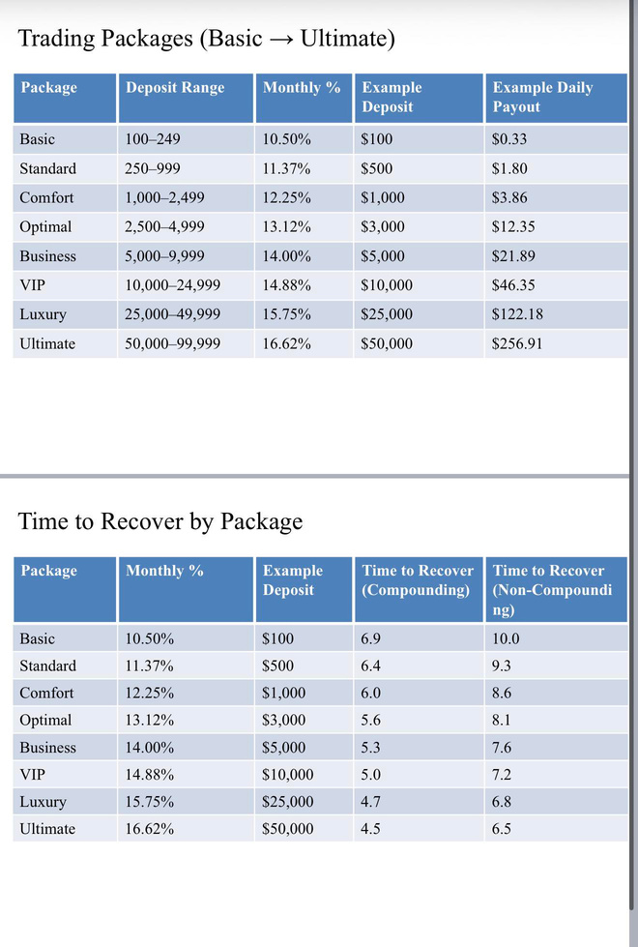
AURUM PROJECT
CRYPTO PROJECT WATCH

Slide 15
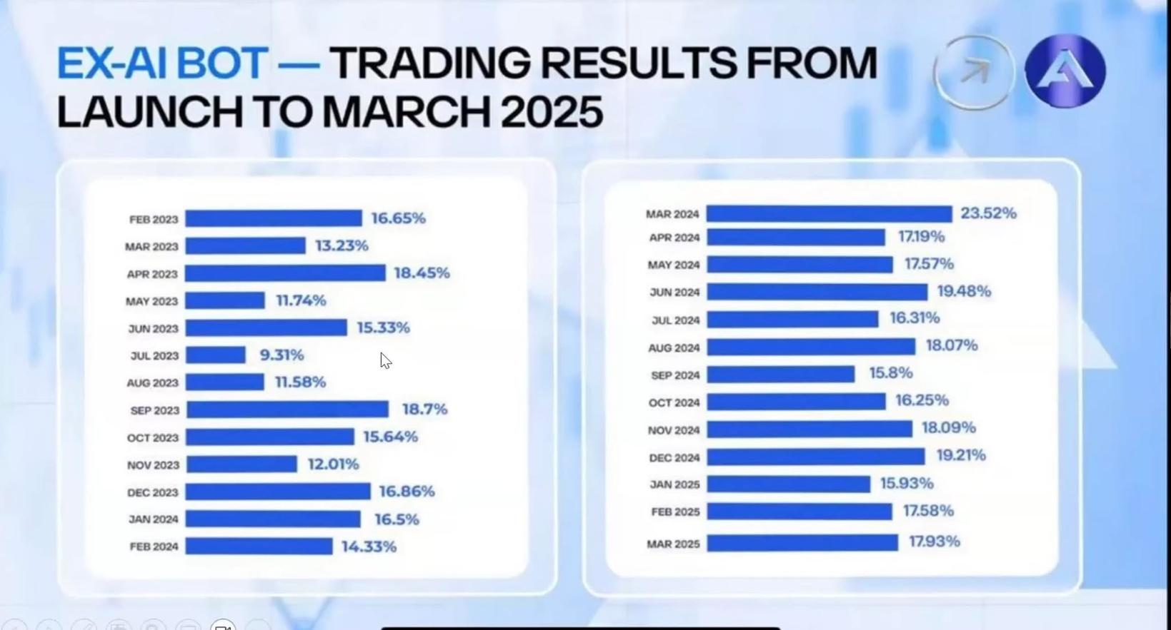
AURUM PROJECT
CRYPTO PROJECT WATCH

Slide 16
AURUM PROJECT
CRYPTO PROJECT WATCH
TRADING PACKAGES
BASIC: $100 - $249.99 10.5% 60/40 SPLIT
STANDARD: $250 - $999.99 11.37 65/35 SPLIT
COMFORT: $1000 - $2499.99 12.25% 70/30
OPTIMAL: $2500 - $4999.99 13.12% 75/25 SPLIT
BUSINESS: $5000 - $9999.99 14% 80/20 SPLIT
VIP: $10000 - $24999.99 15% 85/15 SPLIT
LUXURY: $25000 - $49999.99 15.75% 90/10 SPLIT
ULTIMATE: $50000 - $99999.99 16.62% 95/5 SPLIT
1 YEAR HOLD ON DEPOSIT AUTO REINVEST SHARES START DATE, 35% PENALTY FOR EARLY WITHDRAWL NO PENALTY TO TAKE DAILY PROFITS

Slide 17
AURUM PROJECT
CRYPTO PROJECT WATCH
PACKAGE EXAMPLES
DEPOSIT AMMOUNT TAKE PROFIT REINVEST
$100 $126 YR $361.90 YR
$1000 $1470 YR $4509.99 YR
$2500 $3937.50 YR $12955.25 YR
$5000 $8400 YR $28625.45 YR
$10000 $17850 YR $63175.44 YR
$20000 $35700 YR $137088.50 YR
$50000 $99750 YR $365618.60 YR
$99999 $199498.01 YR $731229.88 YR
PARTNER PROGRAM
Help Aurum grow by refering friends and family. Aurum has a referal program that pays 3% - 18.5% per referal. Get paid immediatly upon deposit of funds. No lock ups or fees on partner payments. Also earn a percentage of your referals daily profits. No limit on sign ups, no wait to get paid just straight forward referal program.

Slide 18
AURUM PROJECT
CRYPTO PROJECT WATCH
HOW TO GET STARTED
YOU WILL NEED A VPN (PAID SUBSCRIPTION)
YOU WILL NEED GOOGLE AUTHENTICATOR (FREE)
A DEVICE THAT CAN ACCESS THE INTERNET
USDT OR USDC TO FUND THE ACCOUNT (WE CAN HELP)
SIGN UP IS QUICK AND EASY
SET A MEETING FOR HELP SIGNING
Contact Mike
info@cryptoprojectwatch.com
720-307-7939
www.cryptoprojectwatch.com

Slide 19
AURUM PROJECT
CRYPTO PROJECT WATCH
RESOURCES
CRYPTOPROJECTWATCH.COM
FACEBOOK: CRYPTO PROJECT WATCH
YOUTUBE: CRYPTO PROJECT WATCH
EMAIL: INFO@CRYPTOPROJECTWATCH.COM
PHONE: 720-307-7939

Slide 20
CRYPTO PROJECT WATCH
THANK YOU
"THE FUTURE OF MONEY IS DIGITAL. ARE YOU READY TO EMBRACE IT?"

